Slide 1
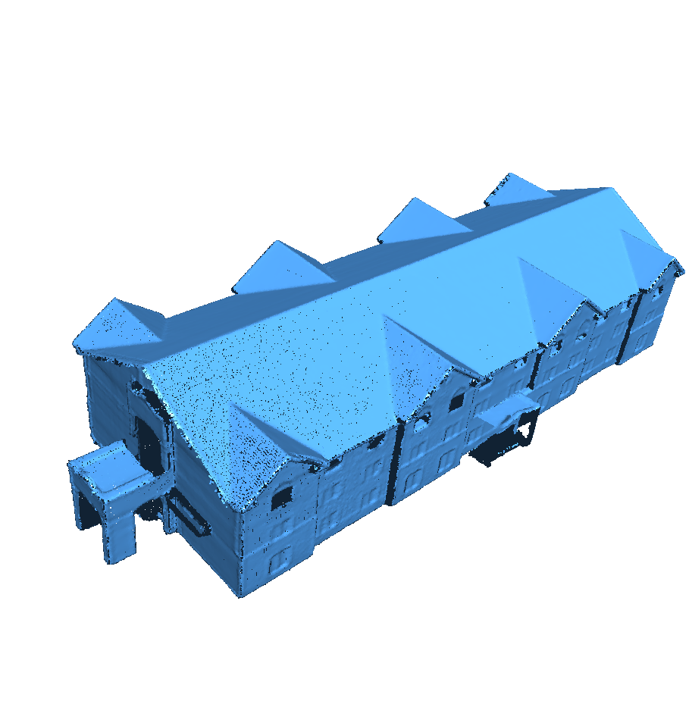
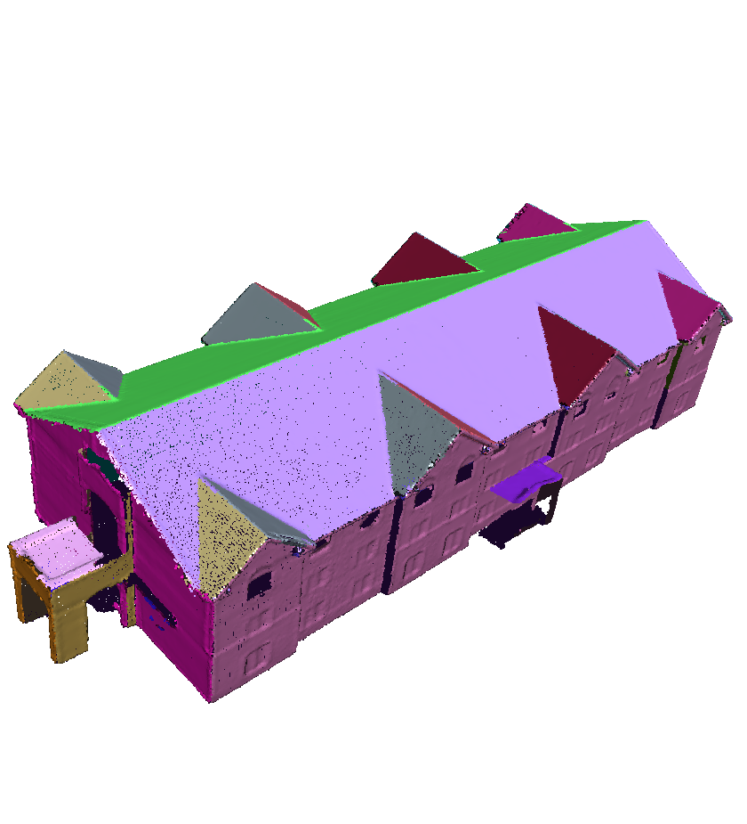
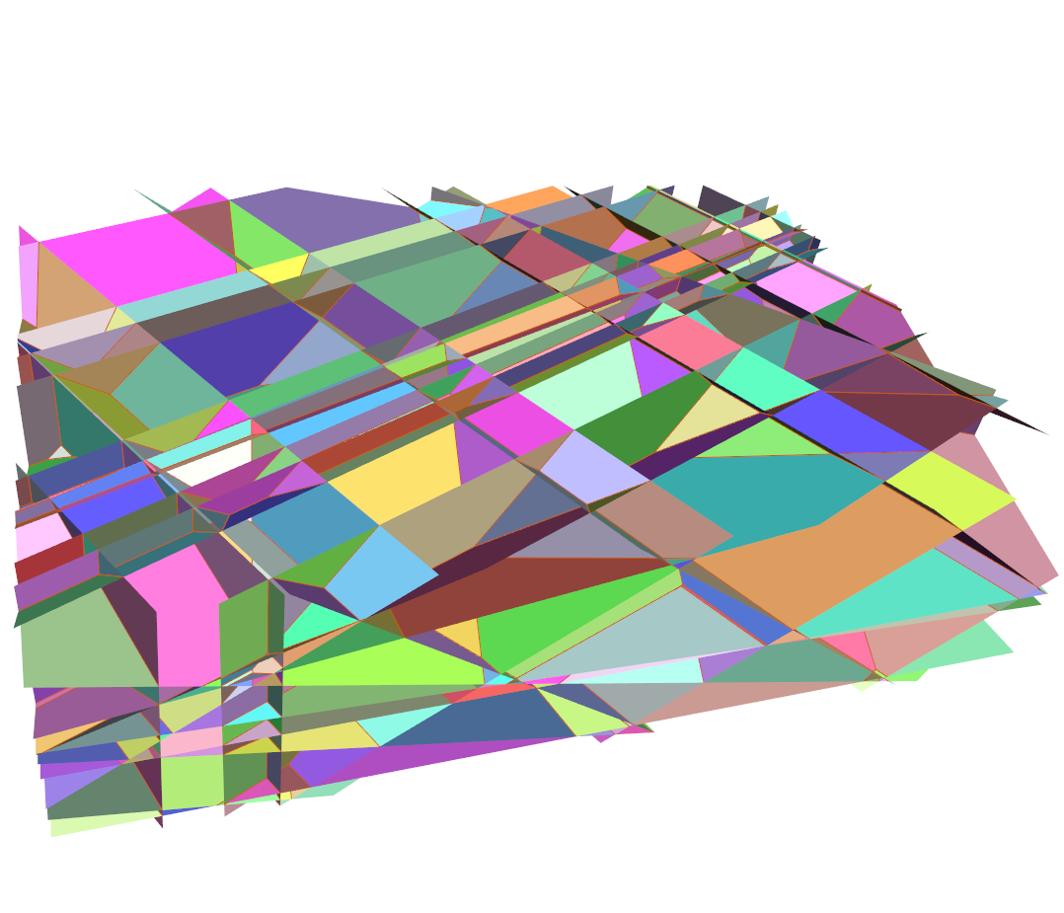
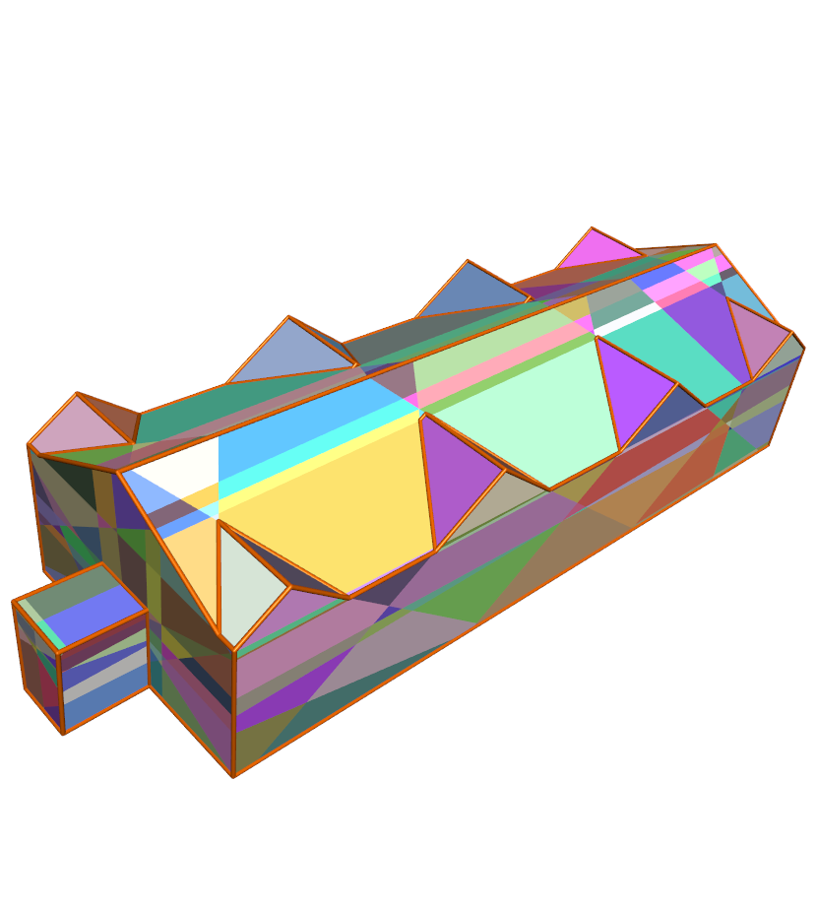
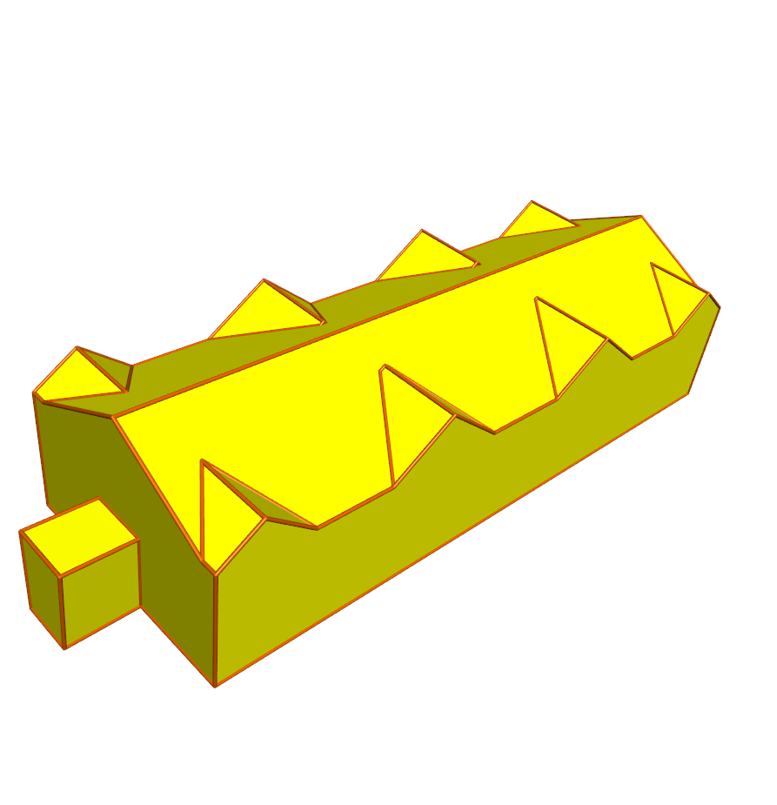
(a) (b) (c) (d) (e)

Slide 2
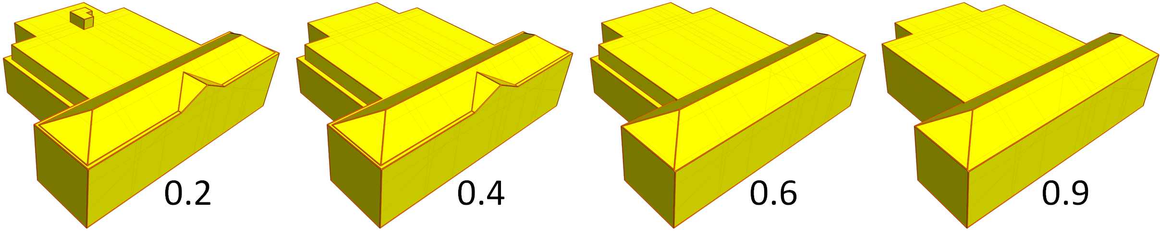
0.2
0.4
0.6
0.9
(a) (b) (c) (d)

Slide 3
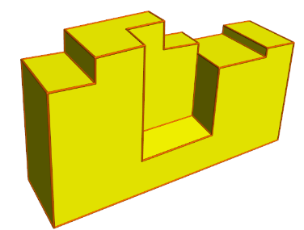
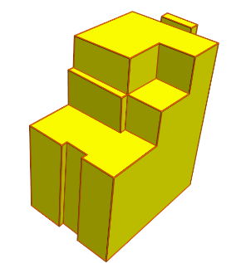
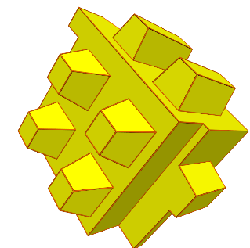
Model | Problem Size | Solver Times
 |  | Gurobi | CBC | SCIP | GLPK | LP_SOLVE
 | # variables: 1244 # constraints: 2660 | 0.05 sec | 0.2 sec | 0.3 sec | 9 sec | 15 min
 | # variables: 2582 # constraints: 5420 | 0.2 sec | 0.6 sec | 2.6 sec | 35 min | -
 | # variables: 21556 # constraints: 44191 | 2 sec | 7.5 sec | 9 sec | - | -

